Slide 1
Bet Performer Valuation
Vinay Gandhi, Mayuresh Wani, Drashti Shah, Parag Paliwal, Rohan Jain

Slide 2
Recommendation
For the Bet Performer, our regression model predicted value of the ship to be $125.8 million, with a 95% confidence interval between $118.8 and $132.7 million
We have used the linear regression approach that uses ship age (Years), deadweight tons (1000s) and economic data in the form of the trailing 1-Year Baltic Capesize index
The predicted price being an estimate might be subject to increase or decrease in case of additional information the client may have (eg, Ship Conditions, shipyard (original builder) , location etc)

Slide 3
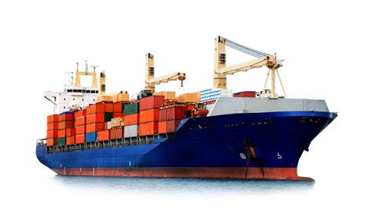
Bet Performer
11-year-old
172,000 DWT
9 holds and hatches
Burmeister & Wain (B&W) 6S70MC Engine
Sold 2 years ago at $70 million
Built by: Nihon Kōkan KabushikiKaisha (NKK) in Japan(1997)

Slide 4
Methodology
A Linear Regression approach is used to predict the cost of the ship. Five different linear models are built, taking independent variables into consideration
These models are changed based on R² value and confidence level and the best model (model five) is selected
Model five gives the most accurate prediction of the value of the ship based on data that was provided

Slide 5
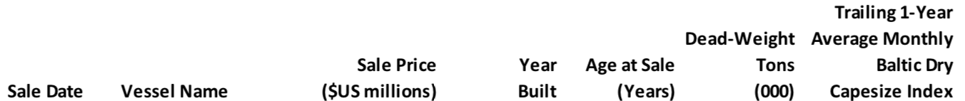
Model 1
The variables taken into consideration are the sale price of the ship and the year in which it was built.

Slide 6
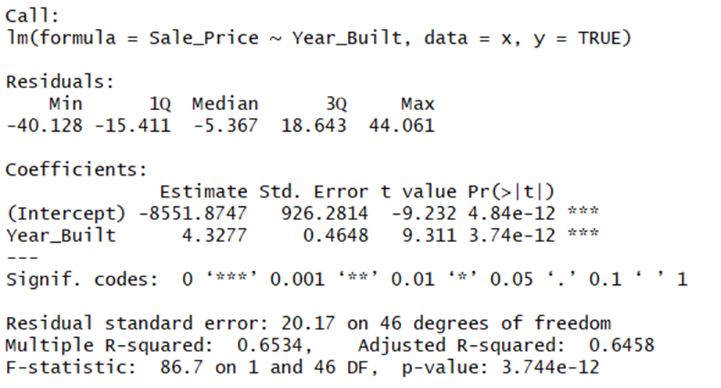
Model 1 - Summary

Slide 7
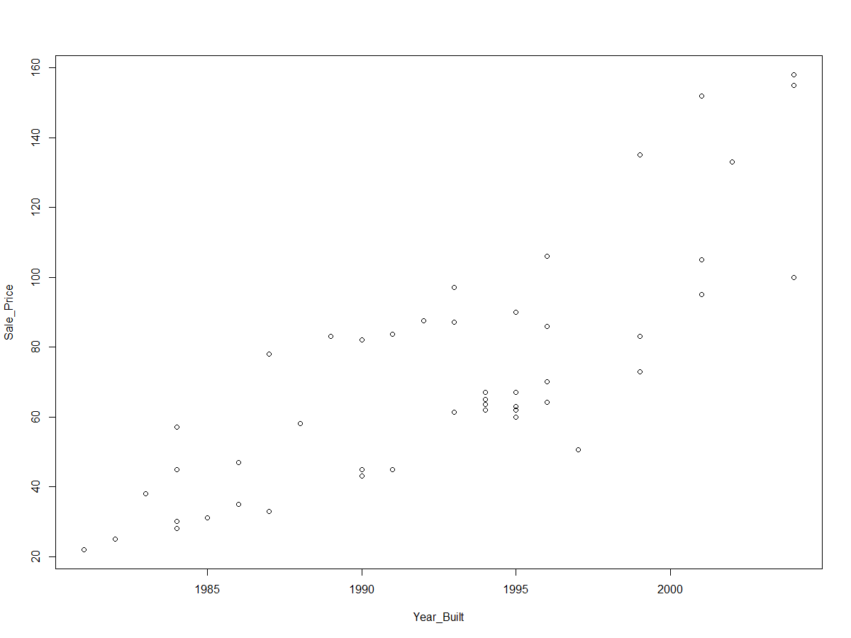
Sale Price vs Year Built

Slide 8
Model 2
The variables taken into consideration are the sale price of the ship, the sale years and the year in which it was built.

Slide 9
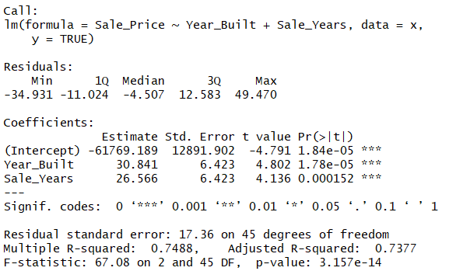
Model 2 – Summary

Slide 10
Model 3
The variables taken into consideration are the sale price of the ship, sale
years, weight and the year in which it was built.

Slide 11
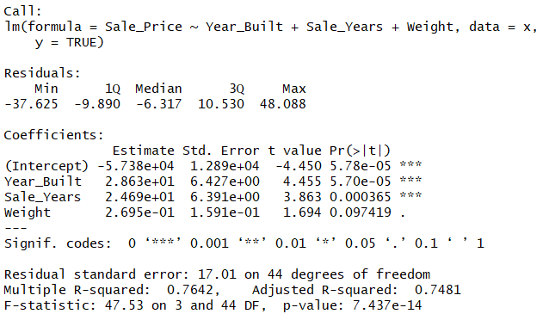
Model 3 – Summary

Slide 12
Model 4
The variables taken into consideration are the sale price of the ship, sale years, weight, capesize and the year in which it was built.

Slide 13
Capesize Index
The index provides composite measure of charter rates across ship types and market
Higher charter rates reflect higher index and a high index means greater value of the ship
High charter rate is reasoned by blooming global economy, increased demand for exports from and imports to China and shortage of ships

Slide 14
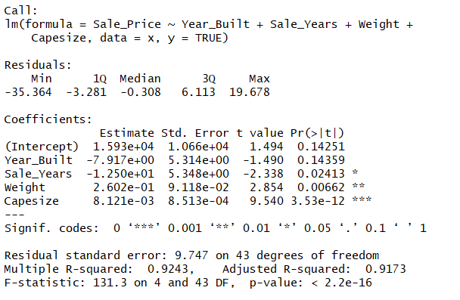
Model 4 – Summary

Slide 15
Model 5
The variables taken into consideration are the sale price of the ship, the sale years, weight and its capesize.

Slide 16
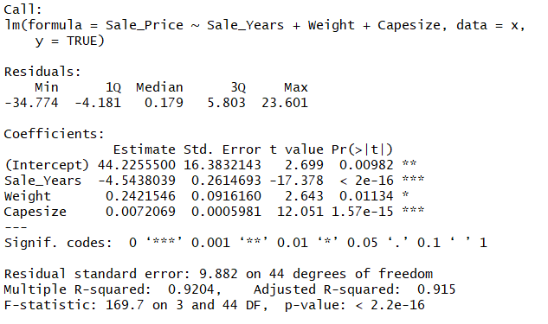
Model 5 – Summary

Slide 17
Overview
Linear Regression Model
Bet Performer - Years = 11 , Weight = 172 (1000 tons) , Capesize = 12476
Sale Price ~ Sale Years, Weight, Capesize
Same Ship was sold 2 years ago at $70 million
Nightflight - $158 million – Years = 4 , Weight = 170 (1000 tons) , Capesize = 11614

Slide 18

Thank You

Slide 19
Appendix

